Slide 1
MODULE -3
ARTIFICIAL NEURAL NETWORKS

Slide 2
CONTENT
Introduction
Neural Network Representation
Appropriate Problems for Neural Network Learning
Perceptrons
Multilayer Networks and BACKPROPAGATION Algorithms
Remarks on the BACKPROPAGATION Algorithms

Slide 3
INTRODUCTION
Artificial neural networks (ANNs) provide a general, practical method for learning real-valued, discrete-valued, and vector-valued target functions from examples.

Slide 4
Biological Motivation
The study of artificial neural networks (ANNs) has been inspired by the observation that biological learning systems are built of very complex webs of interconnected Neurons
Human information processing system consists of brain neuron: basic building block cell that communicates information to and from various parts of body
Simplest model of a neuron: considered as a threshold unit –a processing element (PE)
Collects inputs & produces output if the sum of the input exceeds an internal
threshold value

Slide 5
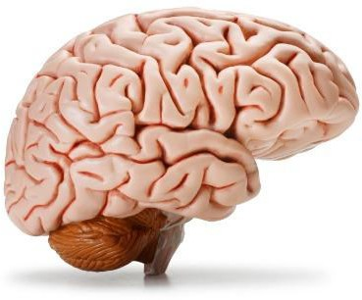

Slide 6
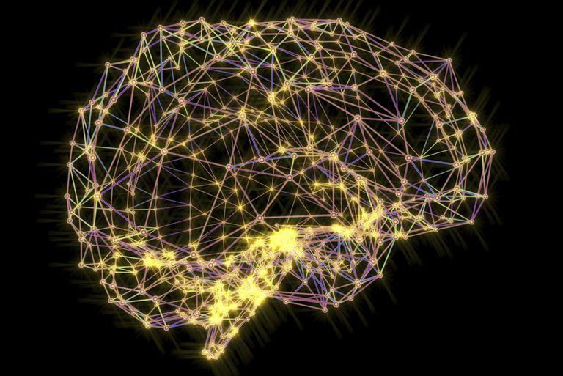

Slide 7
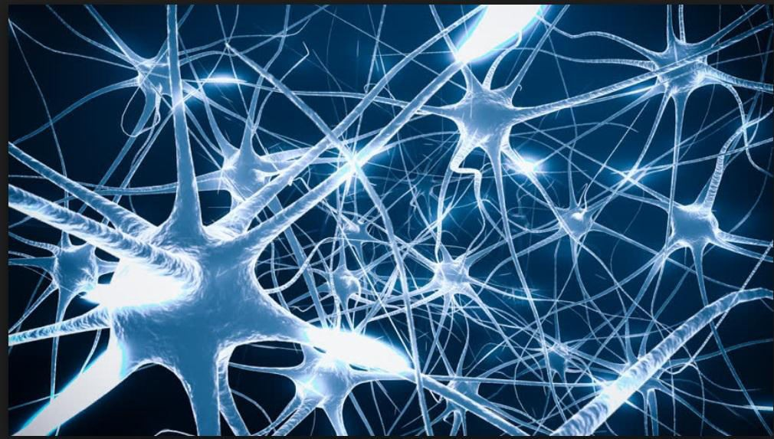

Slide 8
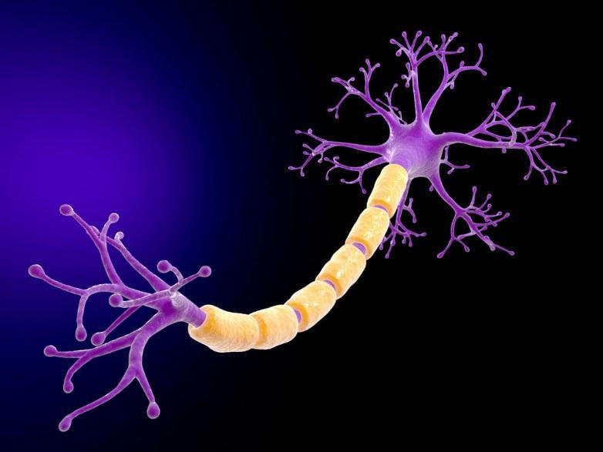

Slide 9
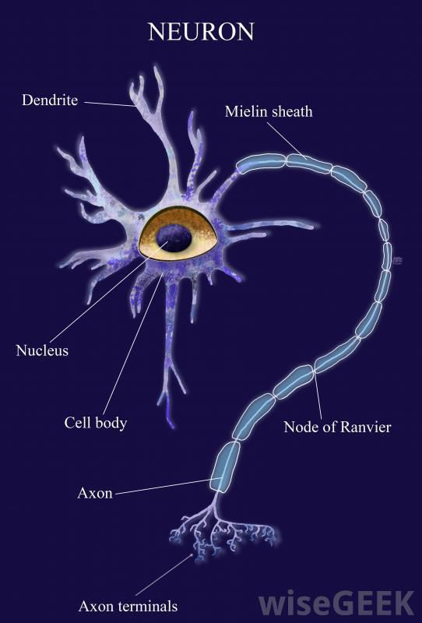

Slide 10
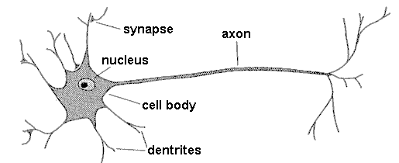

axon
dendrites
synapse
nucleus
cell body

Slide 11
Facts of Human Neurobiology
Number of neurons ~ 10¹¹
Connection per neuron ~ 10 ^{4 – 5}
Neuron switching time ~ 0.001 second or 10 ⁻³
Scene recognition time ~ 0.1 second
100 inference steps doesn’t seem like enough
Highly parallel computation based on distributed representation

Slide 12
Properties of Neural Networks
Many neuron-like threshold switching units
Many weighted interconnections among units
Highly parallel, distributed process
Emphasis on tuning weights automatically
Input is a high-dimensional discrete or real-valued (e.g, sensor input)

Slide 13
When to consider Neural Networks ?
Input is a high-dimensional discrete or real-valued (e.g., sensor input)
Output is discrete or real-valued
Output is a vector of values
Possibly noisy data
Form of target function is unknown
Human readability of result is unimportant
Examples:
Speech phoneme recognition
Image classification
Financial perdition

Slide 14
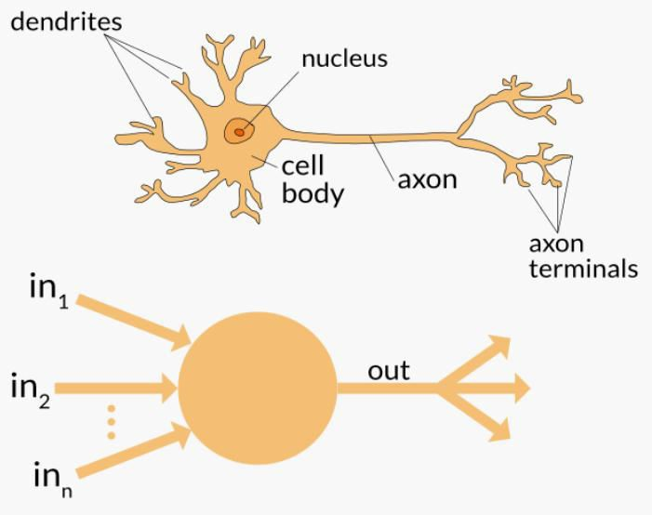
Neuron

Slide 15
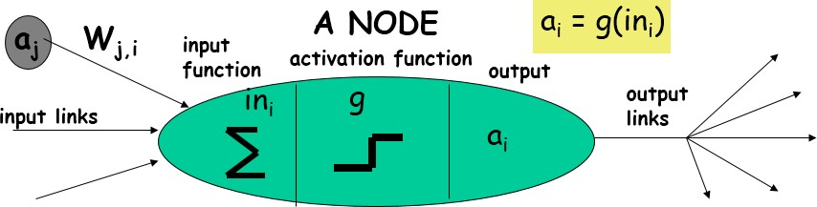
Neuron

Slide 16
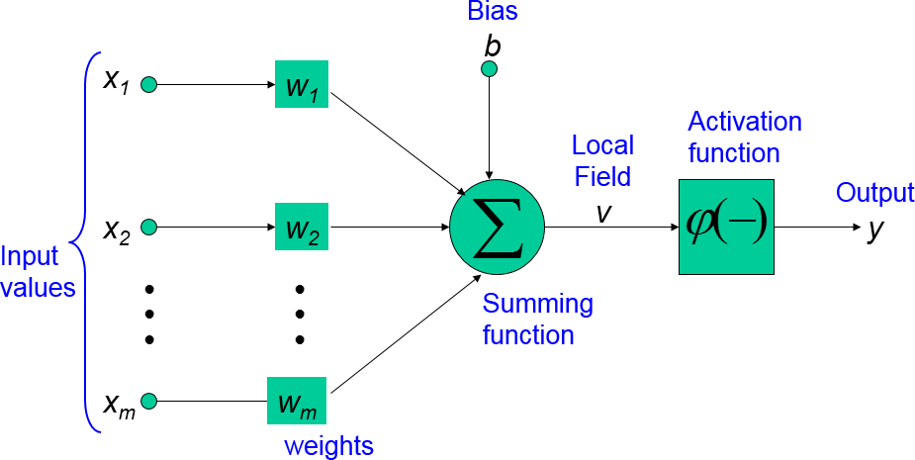
Neuron

Slide 17
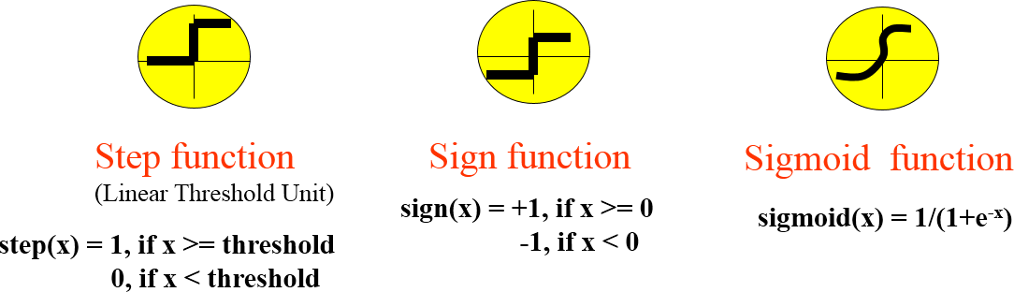
Neuron

Slide 18
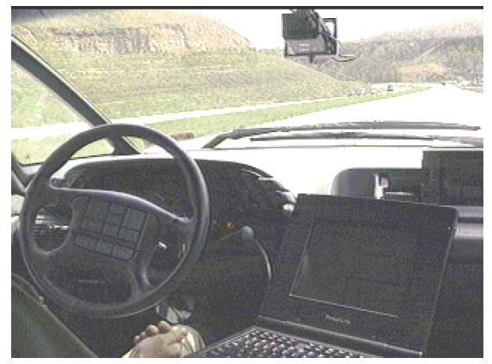
NEURAL NETWORK REPRESENTATIONS

Slide 19
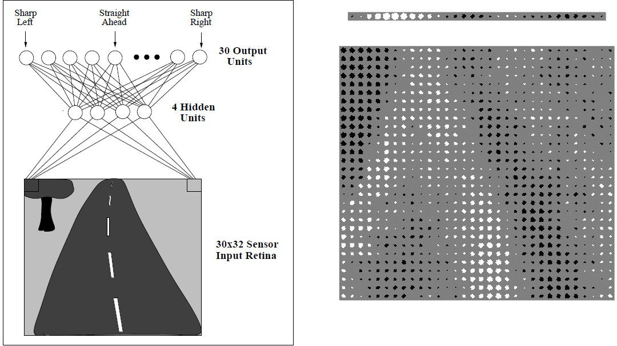

Slide 20
A prototypical example of ANN learning is provided by Pomerleau's (1993) system ALVINN, which uses a learned ANN to steer an autonomous vehicle driving at normal speeds on public highways.
The input to the neural network is a 30x32 grid of pixel intensities obtained from a forward-pointed camera mounted on the vehicle.
The network output is the direction in which the vehicle is steered.

Slide 21
Figure illustrates the neural network representation.
The network is shown on the left side of the figure, with the input camera image depicted below it.
Each node (i.e., circle) in the network diagram corresponds to the output of a
single network unit, and the lines entering the node from below are its inputs.
There are four units that receive inputs directly from all of the 30 x 32 pixels in the image. These are called "hidden" units because their output is available only within the network and is not available as part of the global network output. Each of these four hidden units computes a single real-valued output based on a weighted combination of its 960 inputs
These hidden unit outputs are then used as inputs to a second layer of 30 "output"
units.
Each output unit corresponds to a particular steering direction, and the output values of these units determine which steering direction is recommended most strongly.

Slide 22
The diagrams on the right side of the figure depict the learned weight values associated with one of the four hidden units in this ANN.
The large matrix of black and white boxes on the lower right depicts the weights from the 30 x 32 pixel inputs into the hidden unit. Here, a white box indicates a positive weight, a black box a negative weight, and the size of the box indicates the weight magnitude.
The smaller rectangular diagram directly above the large matrix shows the weights from this hidden unit to each of the 30 output units.

Slide 23
APPROPRIATE PROBLEMS FOR NEURAL NETWORK LEARNING
ANN is appropriate for problems with the following characteristics :
Instances are represented by many attribute-value pairs.
The target function output may be discrete-valued, real-valued, or a vector of several real- or discrete-valued attributes.
The training examples may contain errors.
Long training times are acceptable.
Fast evaluation of the learned target function may be required
The ability of humans to understand the learned target function is not important

Slide 24
Architectures of Artificial Neural Networks
An artificial neural network can be divided into three parts (layers), which are known as:
Input layer: This layer is responsible for receiving information (data), signals, features, or measurements from the external environment. These inputs are usually normalized within the limit values produced by activation functions
Hidden, intermediate, or invisible layers: These layers are composed of neurons which are responsible for extracting patterns associated with the process or system being analysed. These layers perform most of the internal processing from a network.
Output layer : This layer is also composed of neurons, and thus is responsible for producing and presenting the final network outputs, which result from the processing performed by the neurons in the previous layers.

Slide 25
Architectures of Artificial Neural Networks
The main architectures of artificial neural networks, considering the neuron disposition, how they are interconnected and how its layers are composed, can be divided as follows:
Single-layer feedforward network
Multi-layer feedforward networks
Recurrent or Feedback networks
Mesh networks

Slide 26
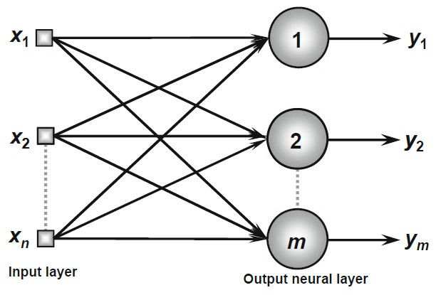
Single-Layer Feedforward Architecture
This artificial neural network has just one input layer and a single neural layer, which is also the output layer.
Figure illustrates a simple-layer feedforward network composed of n inputs and m outputs.
The information always flows in a single direction (thus, unidirectional), which is from the input layer to the output layer

Slide 27
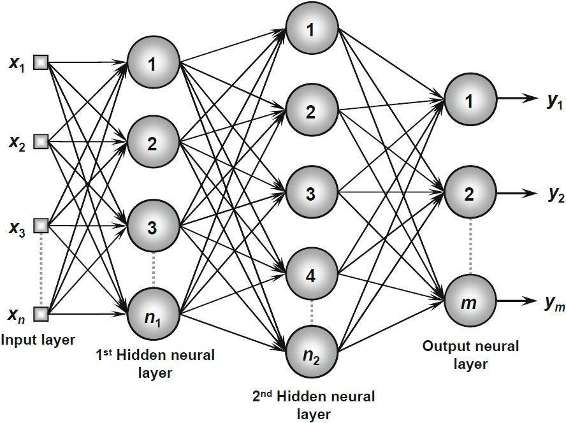
Multi-Layer Feedforward Architecture
This artificial neural feedforward networks with multiple layers are composed of one or more hidden neural layers.
Figure shows a feedforward network with multiple layers composed of one input layer with n sample signals, two hidden neural layers consisting of n₁ and n₂ neurons respectively, and, finally, one output neural layer composed of m neurons representing the respective output values of the problem being analyzed
.

Slide 28
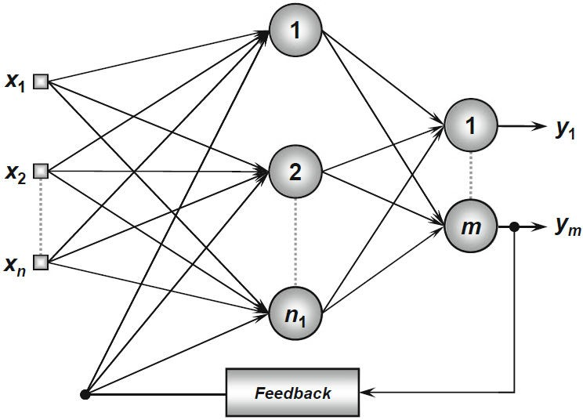
Recurrent or Feedback Architecture
In these networks, the outputs of the neurons are used as feedback inputs for other neurons.
Figure illustrates an example of a Perceptron network with feedback, where one of its output
signals is fed back to the middle layer.

Slide 29
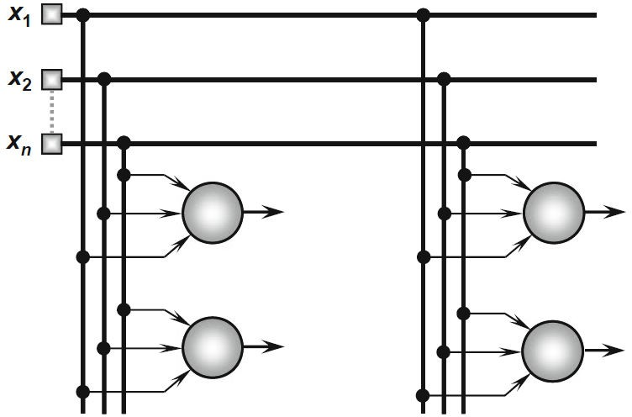
Mesh Architectures
The main features of networks with mesh structures reside in considering the spatial arrangement of neurons for pattern extraction purposes, that is, the spatial localization of the neurons is directly related to the process of adjusting their synaptic weights and thresholds.
Figure illustrates an example of the Kohonen network where its neurons are arranged within a two- dimensional space

Slide 30

PERCEPTRONS
Perceptron is a single layer neural network.
A perceptron takes a vector of real-valued inputs, calculates a linear combination of these inputs, then outputs a 1 if the result is greater than some threshold and -1 otherwise
Given inputs x₁ through x_{n}, the output O(x₁, . . . , x_{n}) computed by the perceptron is
where each w_{i} is a real-valued constant, or weight, that determines the contribution
of input x_{i} to the perceptron output.
-w₀ is a threshold that the weighted combination of inputs w₁x₁ + . . . + w_{n}x_{n} must surpass in order for the perceptron to output a 1.

Slide 31
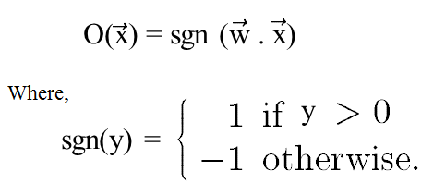

Sometimes, the perceptron function is written as,
Learning a perceptron involves choosing values for the weights w₀ , . . . , w_{n} . Therefore, the space H of candidate hypotheses considered in perceptron learning is the set of all possible real-valued weight vectors
Why do we need Weights and Bias?
Weights shows the strength of the particular node.
A bias value allows you to shift the activation function curve up or down

Slide 32
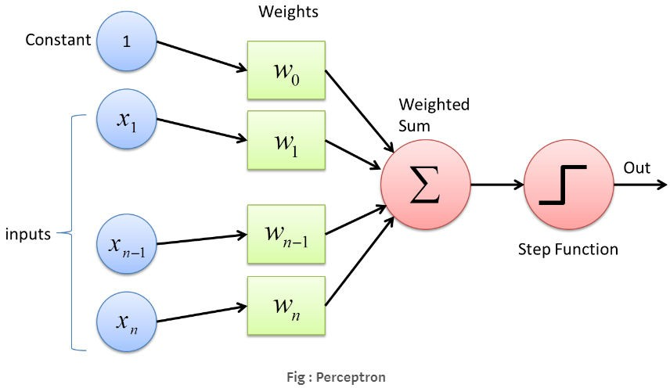

Slide 33
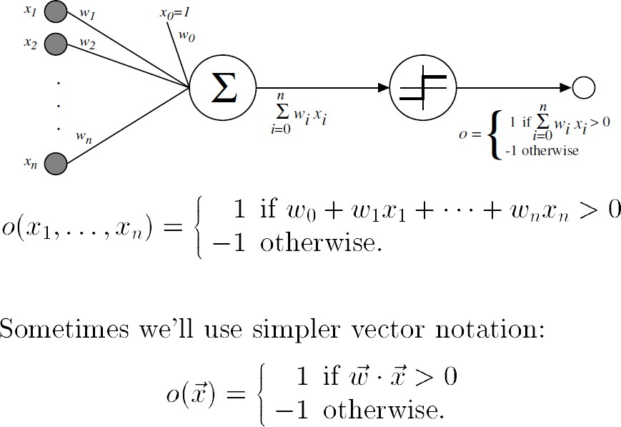

Slide 34
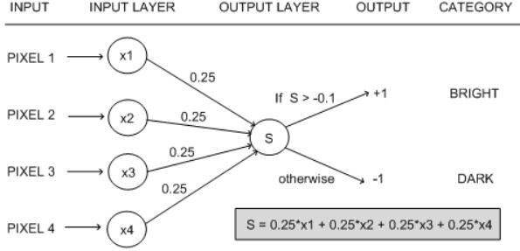
W1=-0.003
W2=0.01
W3=-0.001
W4=0.002

Slide 35
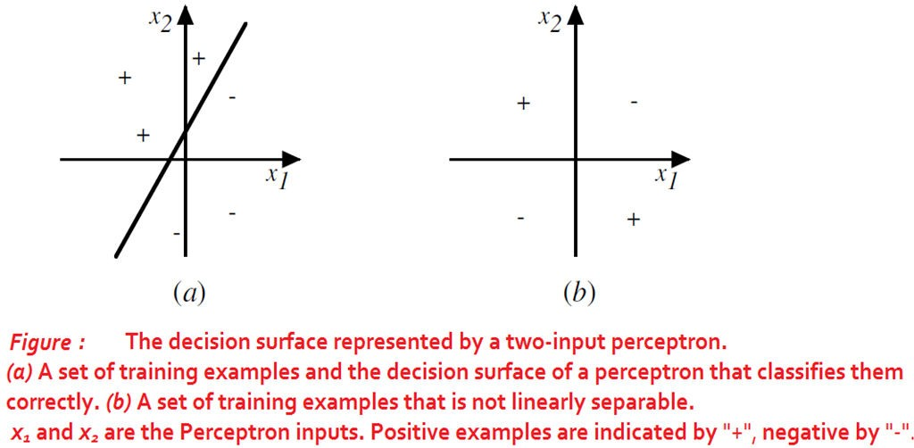
Representational Power of Perceptrons
The perceptron can be viewed as representing a hyperplane decision surface in the n-dimensional space of instances.
The perceptron outputs a 1 for instances lying on one side of the hyperplane and outputs a -1 for instances lying on the other side

Slide 36
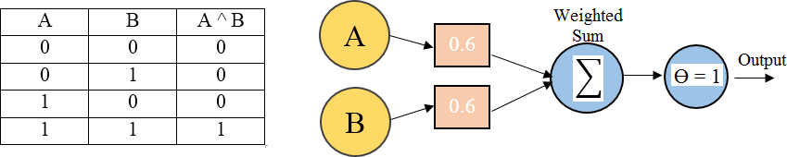
A single perceptron can be used to represent many Boolean functions
AND function
If A=0 & B=0 → 0*0.6 + 0*0.6 = 0.
This is not greater than the threshold of 1, so the output = 0.
If A=0 & B=1 → 0*0.6 + 1*0.6 = 0.6.
This is not greater than the threshold, so the output = 0.
If A=1 & B=0 → 1*0.6 + 0*0.6 = 0.6.
This is not greater than the threshold, so the output = 0.
If A=1 & B=1 → 1*0.6 + 1*0.6 = 1.2.
This exceeds the threshold, so the output = 1.

Slide 37
The Perceptron Training Rule
The learning problem is to determine a weight vector that causes the perceptron to produce the correct + 1 or - 1 output for each of the given training examples.
To learn an acceptable weight vector
Begin with random weights, then iteratively apply the perceptron to each training
example, modifying the perceptron weights whenever it misclassifies an example.
This process is repeated, iterating through the training examples as many times as needed until the perceptron classifies all training examples correctly.
Weights are modified at each step according to the perceptron training rule, which revises the weight w_{i} associated with input x_{i} according to the rule.

Slide 38
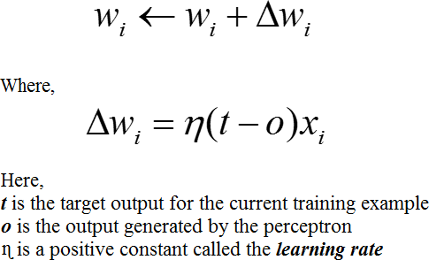
The role of the learning rate is to moderate the degree to which weights are changed at each step. It is usually set to some small value (e.g., 0.1) and is sometimes made to decay as the number of weight-tuning iterations increases
Drawback: The perceptron rule finds a successful weight vector when the training examples are linearly separable, it can fail to converge if the examples are not linearly separable.

Slide 39

Gradient Descent and the Delta Rule
If the training examples are not linearly separable, the delta rule converges toward a best-fit approximation to the target concept.
The key idea behind the delta rule is to use gradient descent to search the hypothesis space of possible weight vectors to find the weights that best fit the training examples.
To understand the delta training rule, consider the task of training an unthresholded
perceptron. That is, a linear unit for which the output O is given by

Slide 40

To derive a weight learning rule for linear units, specify a measure for the training error of a hypothesis (weight vector), relative to the training examples.
Where,
D is the set of training examples,
t_{d} is the target output for training example d,
o_{d} is the output of the linear unit for training example d
E [ w ] is simply half the squared difference between the target output t_{d} and the linear unit output o_{d}, summed over all training examples.

Slide 41
Visualizing the Hypothesis Space
To understand the gradient descent algorithm, it is helpful to visualize the entire hypothesis space of possible weight vectors and their associated E values as shown in below figure.
Here the axes w₀ and w_{l} represent possible values for the two weights of a simple linear unit. The w₀, w_{l} plane therefore represents the entire hypothesis space.
The vertical axis indicates the error E relative to some fixed set of training
examples.
The arrow shows the negated gradient at one particular point, indicating the direction in the w₀, w_{l} plane producing steepest descent along the error surface.
The error surface shown in the figure thus summarizes the desirability of every weight vector in the hypothesis space

Slide 42
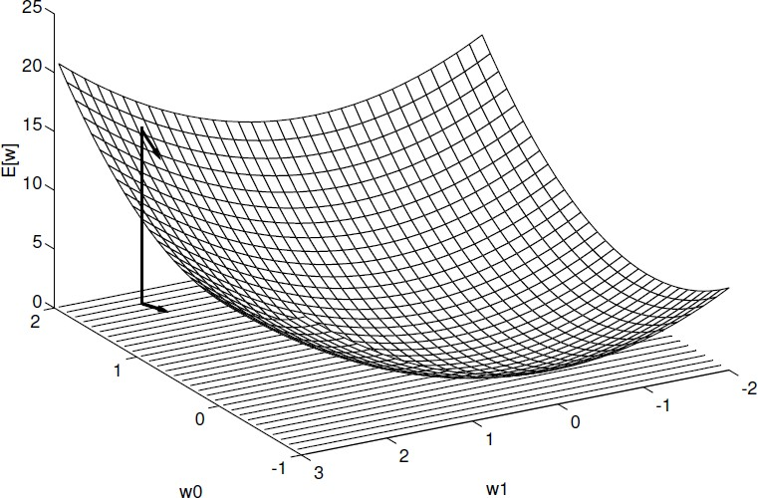
Given the way in which we chose to define E, for linear units this error surface must always be parabolic with a single global minimum.
Gradient descent search determines a weight vector that minimizes E by starting with an arbitrary
initial weight vector, then repeatedly modifying it in small steps.
At each step, the weight vector is altered in the direction that produces the steepest descent along the error surface depicted in above figure. This process continues until the global minimum error is reached.

Slide 43
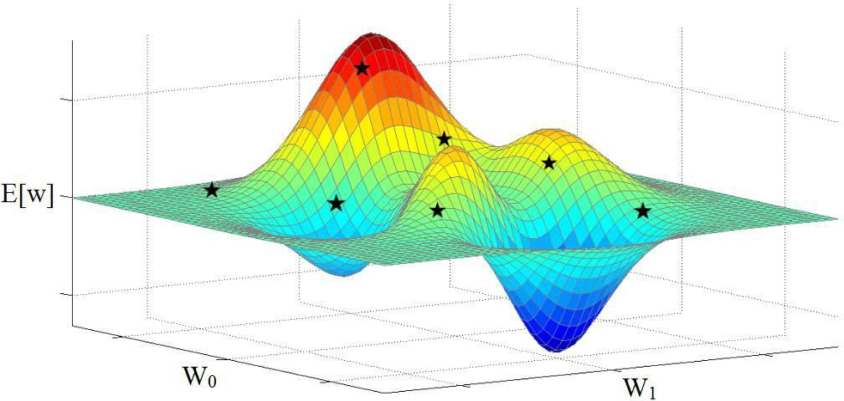

Slide 44
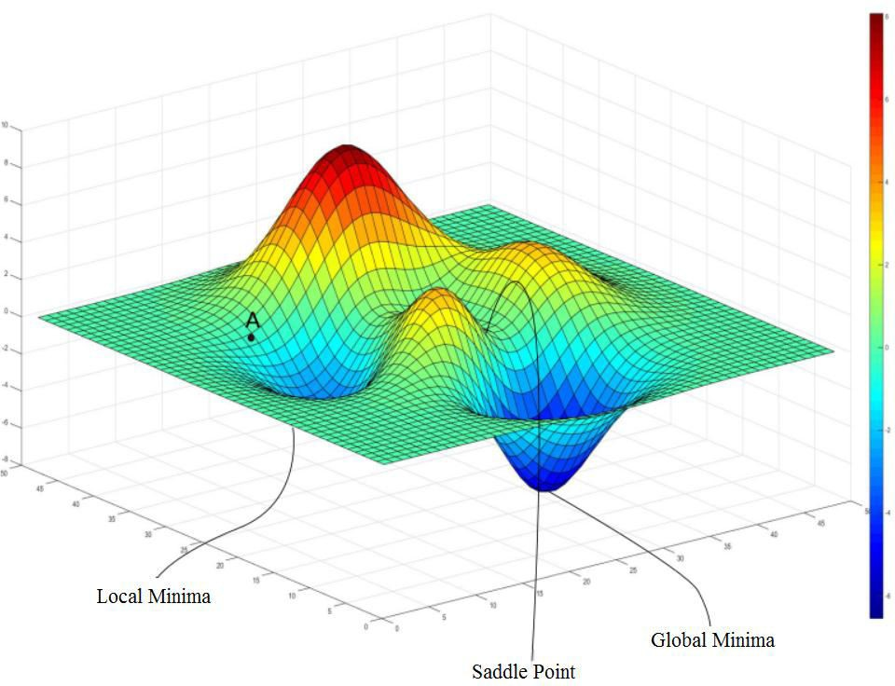

Slide 45
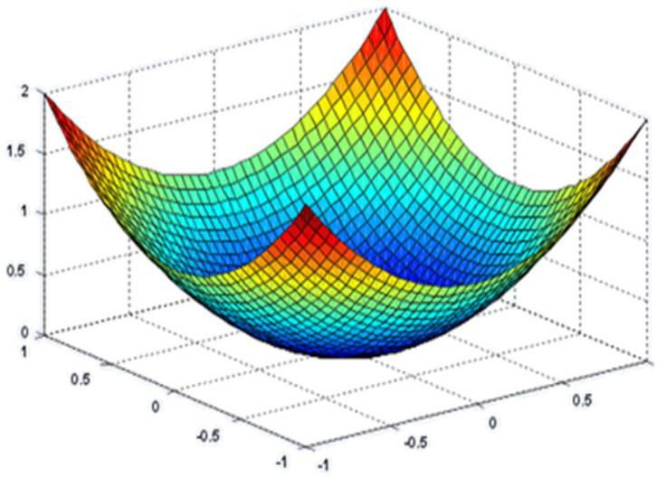

Slide 46
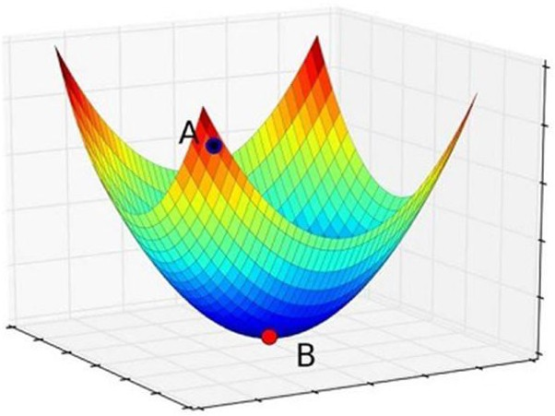

Slide 47

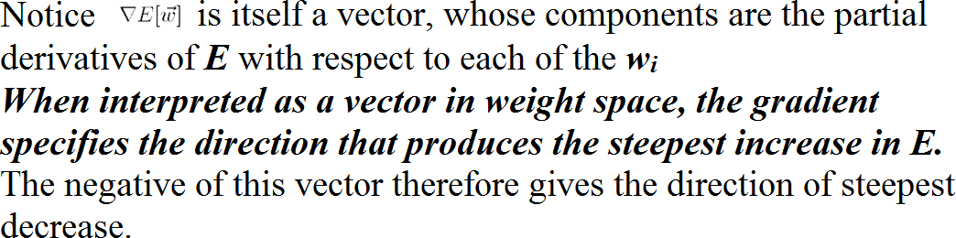
Derivation of the Gradient Descent Rule
How to calculate the direction of steepest descent along the error surface?
The direction of steepest can be found by computing the derivative of E with respect to each component of the vector w . This vector derivative is called the gradient of E with respect to w , written as

Slide 48
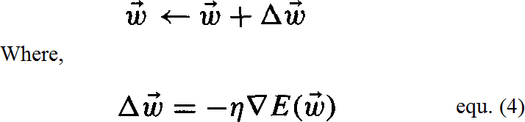
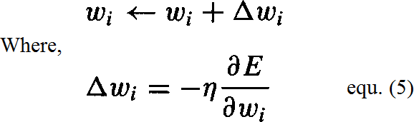
The gradient specifies the direction of steepest increase of E, the training rule for gradient descent is
Here η is a positive constant called the learning rate, which determines the step
size in the gradient descent search.
The negative sign is present because we want to move the weight vector in the direction that decreases E
This training rule can also be written in its component form

Slide 49
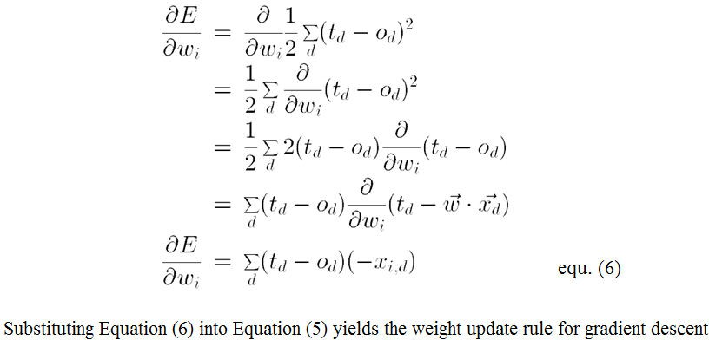

Calculate the gradient at each step. The vector of differentiating E from Equation (2), as
𝜕𝐸
derivatives that form the gradient can be obtained by
𝜕𝑤𝑖

Slide 50
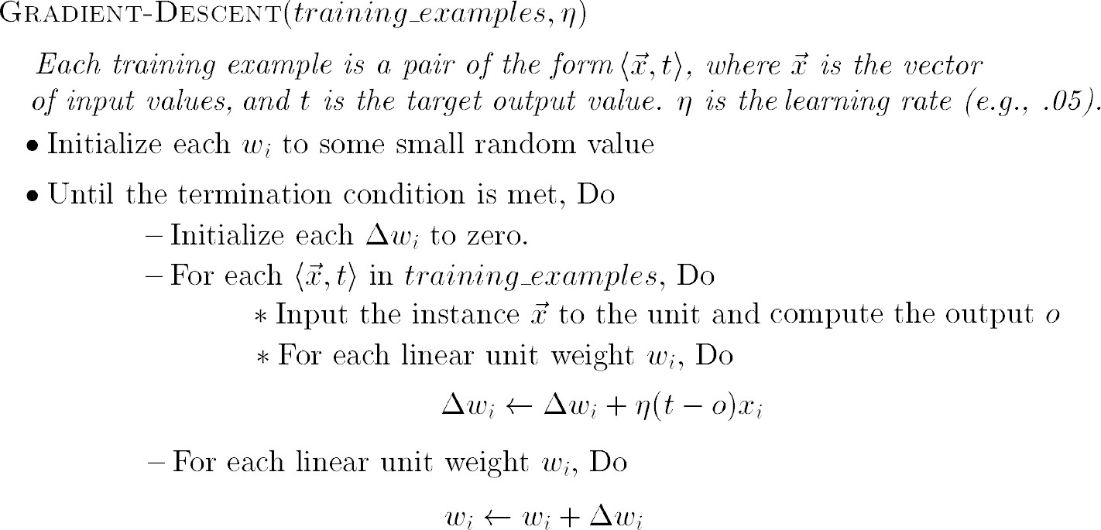
GRADIENT DESCENT algorithm for training a linear unit

Slide 51
To summarize, the gradient descent algorithm for training linear units is as follows:
Pick an initial random weight vector.
Apply the linear unit to all training examples, then compute Δw_{i} for each weight according to Equation (7).
Update each weight w_{i} by adding Δw_{i}, then repeat this process

Slide 52
Features of Gradient Descent Algorithm
Gradient descent is an important general paradigm for learning. It is a strategy for searching through a large or infinite hypothesis space that can be applied whenever
The hypothesis space contains continuously parameterized hypotheses
The error can be differentiated with respect to these hypothesis parameters
The key practical difficulties in applying gradient descent are
Converging to a local minimum can sometimes be quite slow
If there are multiple local minima in the error surface, then there is no guarantee that the procedure will find the global minimum

Slide 53
Stochastic Approximation to Gradient Descent
The gradient descent training rule presented in Equation (7) computes weight updates after summing over all the training examples in D
The idea behind stochastic gradient descent is to approximate this gradient descent search by updating weights incrementally, following the calculation of the error for each individual example
where t, o, and x_{i} are the target value, unit output, and i^{th} input for the training example in question

Slide 54
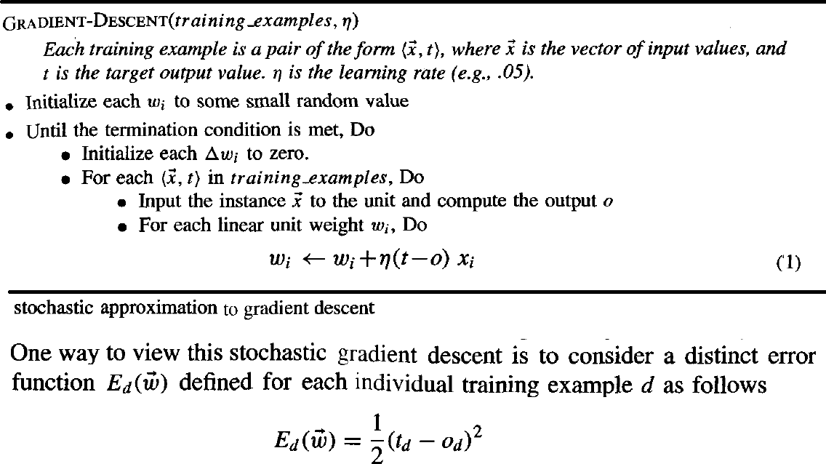

Slide 55

One way to view this stochastic gradient descent is to consider a distinct error function E_{d} ( w ) for each individual training example d as follows
Where, t_{d} and o_{d} are the target value and the unit output value for training example d.
Stochastic gradient descent iterates over the training examples d in D, at each iteration altering the weights according to the gradient with respect to E_{d}( w )
The sequence of these weight updates, when iterated over all training examples, provides a reasonable approximation to descending the gradient with respect to our original error function E_{d} ( w )
By making the value of η sufficiently small, stochastic gradient descent can be made to approximate true gradient descent arbitrarily closely

Slide 56
The key differences between standard gradient descent and stochastic gradient descent are
In standard gradient descent, the error is summed over all examples before updating weights, whereas in stochastic gradient descent weights are updated upon examining each training example.
Summing over multiple examples in standard gradient descent requires more computation per weight update step. On the other hand, because it uses the true gradient, standard gradient descent is often used with a larger step size per weight update than stochastic gradient descent.
In cases where there are multiple local minima with respect to stochastic gradient descent can sometimes avoid falling into these local minima because it uses the various 𝛻E_{d} ( w ) rather than 𝛻E ( w ) to guide its search

Slide 57
MULTILAYER NETWORKS AND THE BACKPROPAGATION ALGORITHM
Multilayer networks learned by the BACKPROPACATION algorithm are capable
of expressing a rich variety of nonlinear decision surfaces

Slide 58
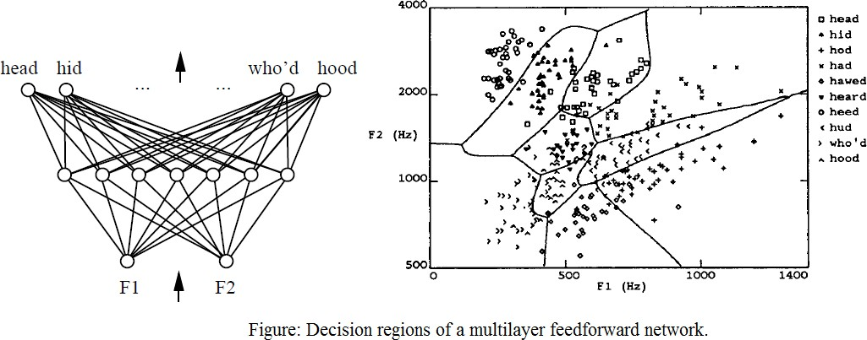
Decision regions of a multilayer feedforward network. The network shown here was trained to recognize 1 of 10 vowel sounds occurring in the context "h_d" (e.g., "had," "hid"). The network input consists of two parameters, F1 and F2, obtained from a spectral analysis of the sound. The 10 network outputs correspond to the 10 possible vowel sounds. The network prediction is the output whose value is highest.
The plot on the right illustrates the highly nonlinear decision surface represented by the learned network. Points shown on the plot are test examples distinct from the examples used to train the network.

Slide 59
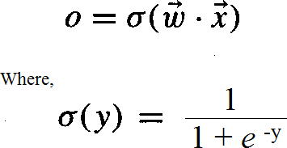
A Differentiable Threshold Unit
Sigmoid unit-a unit very much like a perceptron, but based on a smoothed, differentiable threshold function.
The sigmoid unit first computes a linear combination of its inputs, then applies a threshold to the result. In the case of the sigmoid unit, however, the threshold output is a continuous function of its input.
More precisely, the sigmoid unit computes its output O as
σ is the sigmoid function

Slide 60
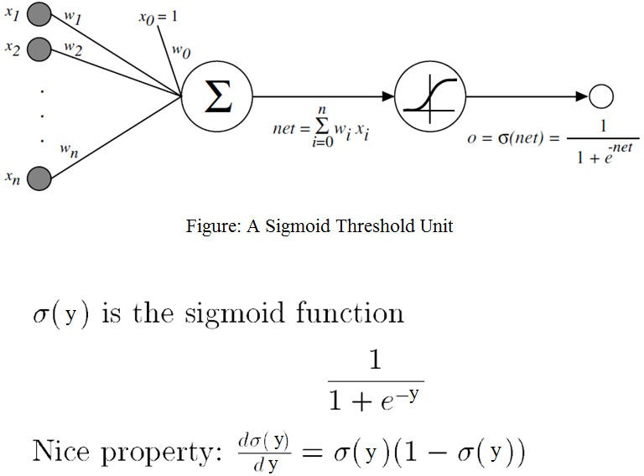

Slide 61
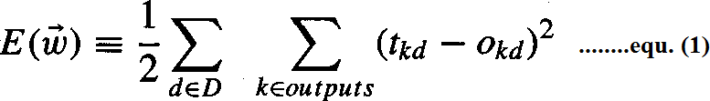
The BACKPROPAGATION Algorithm
The BACKPROPAGATION Algorithm learns the weights for a multilayer network, given a network with a fixed set of units and interconnections. It employs gradient descent to attempt to minimize the squared error between the network output values and the target values for these outputs.
In BACKPROPAGATION algorithm, we consider networks with multiple output units rather than single units as before, so we redefine E to sum the errors over all of the network output units.
where,
outputs - is the set of output units in the network
t_{kd} and O_{kd} - the target and output values associated with the k^{th} output unit
d - training example

Slide 62
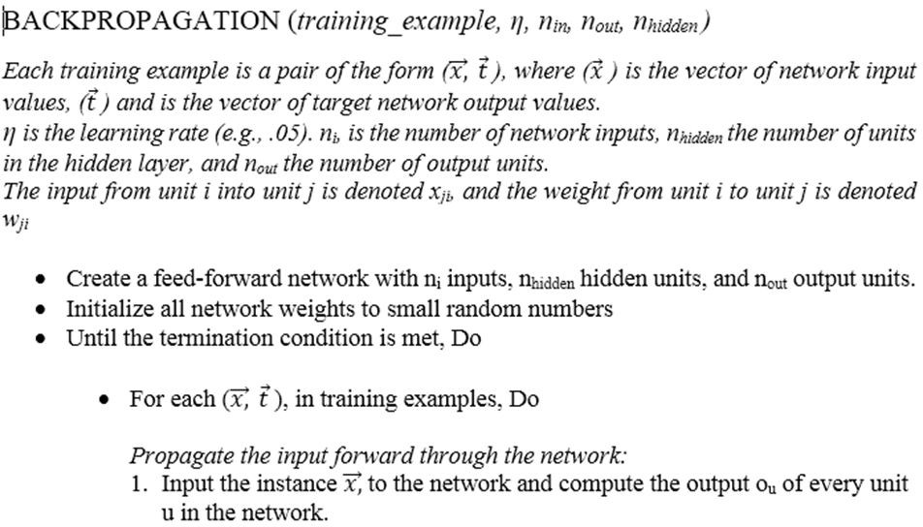

Slide 63
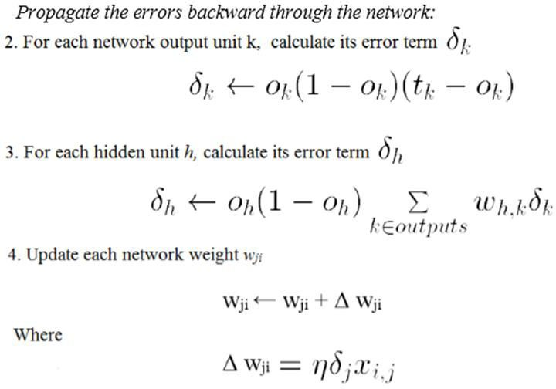

Slide 64
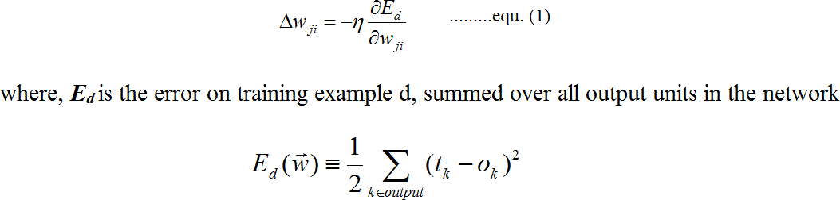
Derivation of the BACKPROPAGATION Rule
Deriving the stochastic gradient descent rule: Stochastic gradient descent involves iterating through the training examples one at a time, for each training example d descending the gradient of the error E_{d} with respect to this single example
For each training example d every weight w_{ji} is updated by adding to it Δ w_{ji}
Here outputs is the set of output units in the network, t_{k} is the target value of unit k for
training example d, and o_{k} is the output of unit k given training example d.

Slide 65
The derivation of the stochastic gradient descent rule is conceptually straightforward, but requires keeping track of a number of subscripts and variables
x_{ji} = the i^{th} input to unit j
w_{ji} = the weight associated with the i^{th} input to unit j net_{j} = Σ_{i} w_{ji}x_{ji} (the weighted sum of inputs for unit j )
o_{j} = the output computed by unit j t_{j} = the target output for unit j
σ = the sigmoid function
outputs = the set of units in the final layer of the network
Downstream(j) = the set of units whose immediate inputs include the output of unit j

Slide 66
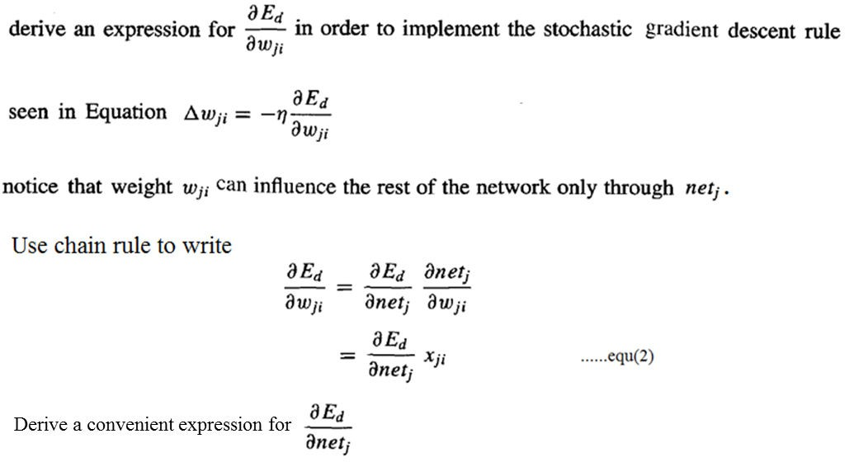
Consider two cases in turn: the case where unit j is an output unit for the network, and the case where j is an
internal unit (hidden unit).

Slide 67
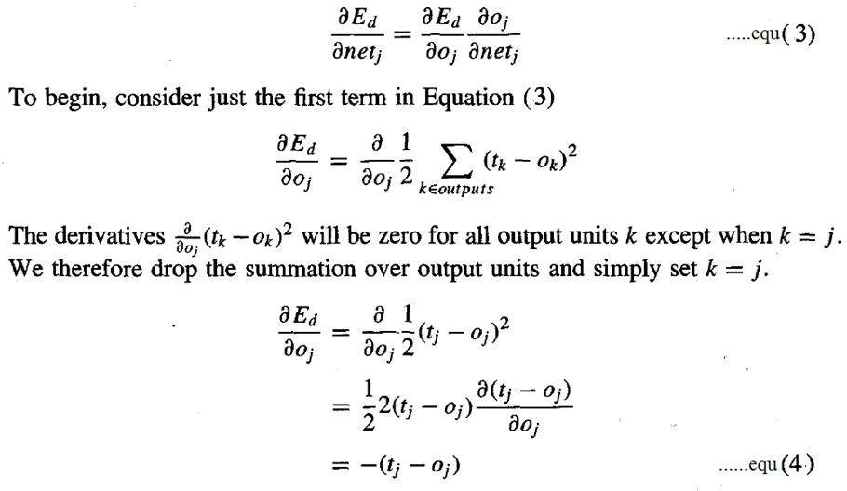
Case 1: Training Rule for Output Unit Weights.
w_{ji} can influence the rest of the network only through net_{j} , net_{j} can influence the network only through o_{j}.
Therefore, we can invoke the chain rule again to write

Slide 68
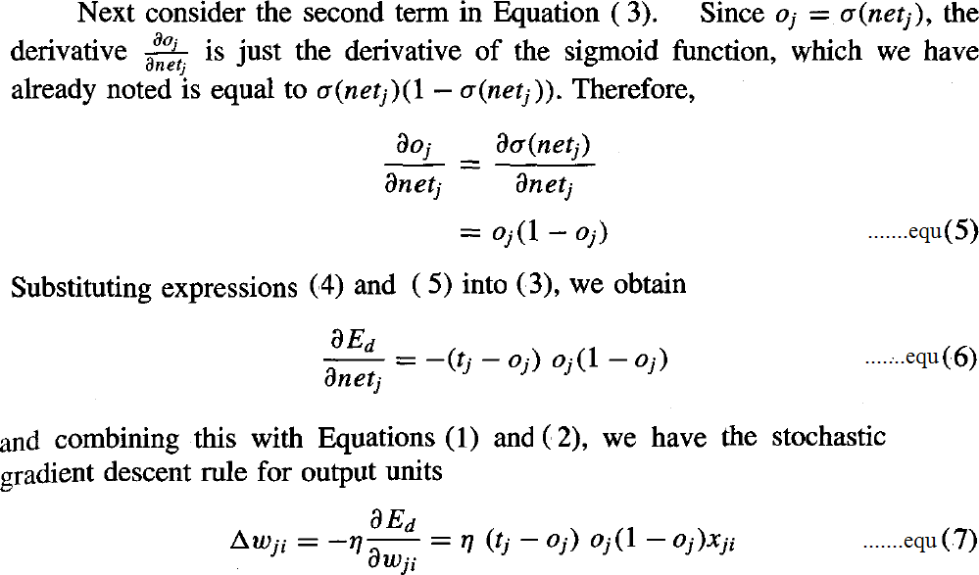

Slide 69
Case 2: Training Rule for Hidden Unit Weights.
In the case where j is an internal, or hidden unit in the network, the derivation of the training rule for w_{ji} must take into account the indirect ways in which w_{ji} can influence the network outputs and hence E_{d}.
For this reason, we will find it useful to refer to the set of all units immediately downstream of unit j in the network and denoted this set of units by Downstream( j).
net_{j} can influence the network outputs only through the units in Downstream(j).
Therefore, we can write

Slide 70
